Slide 1
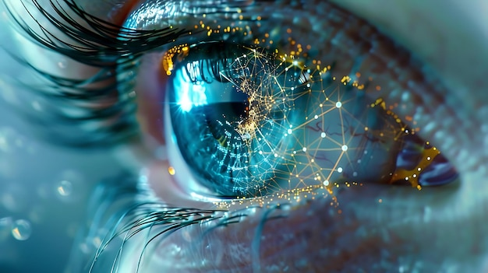
Mouse control using Eye gaze and Eyeblinks
Presented By-
Aryan Kumar
Anand Banoth
Ankit Kumar
Priyansh Chakravorty

Slide 2
Introduction
Traditional mouse and pointer systems require physical contact, which can be restrictive in hands-free environments or for users with mobility limitations.
This project addresses these challenges by introducing a virtual mouse controlled using eye movements and eyeblinks, allowing users to move the cursor, click, scroll etc without direct interaction.
Using computer vision and gesture recognition via OpenCV, MediaPipe and PyAutoGUI this system offers an innovative, touch-free interface that is both accessible and practical.
Beyond enhancing accessibility, it provides a dynamic alternative for presentations, replacing the need for laser pointers and enhancing engagement through intuitive, hands-free control.

Slide 3
Problem Statement
Objective: To create a virtual mouse controlled by eye movements and eyeblinks using a webcam feed.
Input: Live video feed from webcam.
Output: Mouse actions (move, left-click, right-click, scroll) as well as accuracy and the avg response time for those actions based on eye controls.
Constrain:
Real - time performance for smooth interaction.
Accurate eye landmark detection.
Limited to common gesture for simplicity.

Slide 4
Literature Review
What Has Been Done Before?
Basic virtual mouse using OpenCV, MediaPipe, and PyAutoGUI. This code allowed for tracking face landmarks, and cursor movement based on the position of right eye. The main focus was on basic functionalities such as moving the cursor and simulating left and right click actions.
More advanced version added features like scrolling and gesture recognition for left and right clicks.

Slide 5
Literature Review
How our work is different?
Our approach builds on these existing implementations but specifically tailors them for enhanced user interaction in presentation and lecture scenarios:
Enhanced Gesture Recognition: Our code expands the range of recognized gestures, such as scroll up, scroll down and toggling between mouse control and eye control making it more versatile for presentation control.

Slide 6
Literature review
How our work is different?
Augmented Use Case for Presentations: The focus was shifted to creating a reliable tool that presenters can use hands-free for slide navigation, pointer movement, and engaging with the screen without physical contact or traditional devices like a mouse or laser pointer.

Slide 7
Propose Method
Webcam Input
Eye Landmarks movement
Face Landmarks Detection (MediaPipe)
Action Exeution (Py AutoGUI)
Mouse Control Action
Step-by-Step Approach:
Step 1: Capture video feed from the webcam.
Step 2: Use face mark detection model to locate eye landmarks.
Step 3: Map specific eye movements to mouse actions using PyAutoGUI.
Step 4: Display the processed video to visualize gestures in real-time.

Slide 8
MediaPipe is Used for its robust and fast face landmark detection . PyAutoGUi allows easy integration with OS-level mouse control .
Rationale:

Slide 9
Implementation Details: 1. Libraries used:
OpenCV
MediaPipe
PyAutoGUI
Used for video capture and Frame Capture
Used For Face Landmark detection
Used for mouse actions (click , scroll, move etc)

Slide 10
Gesture mapping
Scroll Up: Right eye positioned higher than the left eye
Scroll Down: Left eye positioned higher than the right eye
Mouse control toggle: Open mouth to toggle mouse control on/off:
Cursor movement: The horizontal and vertical position of the right eye
Left Click: Left eye wink
Right click: Right eye wink

Slide 11
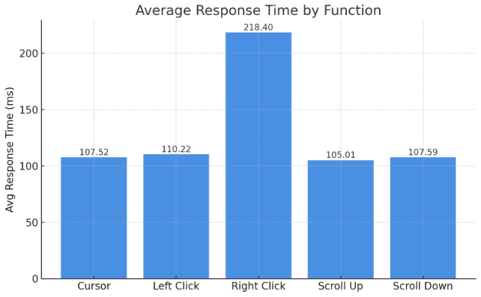
Graph for Average Response Time Across Different Gestures

Slide 12
Observations:
Performance:
real-time responsiveness with slight delay due to eye landmark detection and action
trigger.
Limitations:
Sensitivity to lighting and head positioning.
Some gestures may overlap, causing unintended actions.
In dark environment software didn’t work properly in detecting eye gesture.
Advantages:
Hands-free control over the mouse.
Potential applications in touchless interfaces.

Slide 13
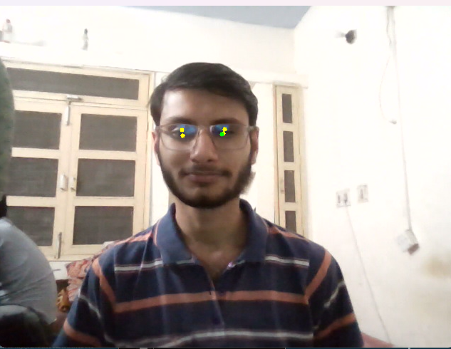
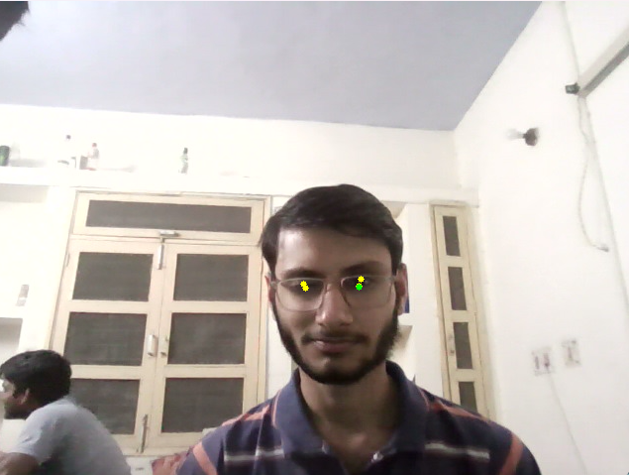
Implementation Demo:
Left Click
Right Click

Slide 14
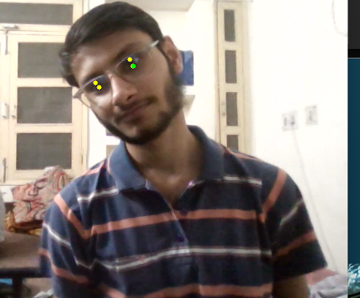
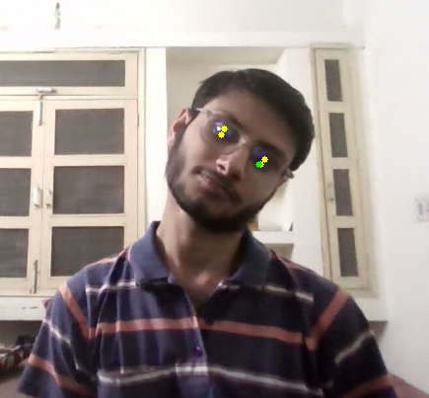
Scroll Up
Scroll down

Slide 15
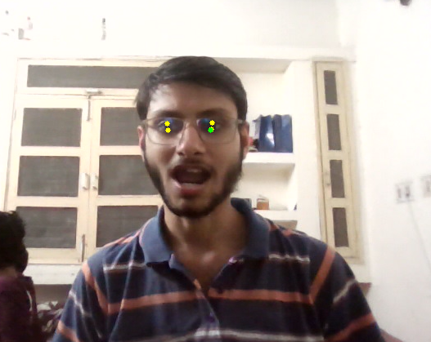
Closing the Program

